Slide 1


<Ravi>
<Sept 25 2022>

Slide 2
Outline
Executive Summary
Introduction
Methodology
Results
Conclusion
Appendix

Slide 3

Executive Summary
Summary of methodologies
Data collection steps include REST API's and Web Scraping
Data Wrangling methods include converting classification variables into binary values or unit vectors via one-hot-encoding
Null values were dealt with by replacing them with either the mean or 0
SQL queries and scatter plots were used to initially investigate the data to get the important features for predictive analysis
Classification models were used to make predictions in the end
Summary of all results
Features such as Orbit, Launch Site, Flight Number, and more seemed to be the most relevant
All classification models performed at about 83%, with the error mostly lying in false positive detection

Slide 4
Introduction
The project is about looking at SpaceX data to predict and reduce cost of rockets.
Rockets that can land safely in the first stage of launch significantly reduce cost, so this is an important metric that will be considered and predicted.
But ultimately, the goal is to determine the price of a rocket launch using machine learning methodologies rather than rocket science.

Slide 5

Section 1

Slide 6
Methodology
Executive Summary
Data collection methodology:
We will detail the data collection methods, which include a SpaceX REST API, and Web Scraping.
Perform data wrangling
We will also detail how we converted certain classification variables into data that our algorithms can work with.
Perform exploratory data analysis (EDA) using visualization and SQL
Perform interactive visual analytics using Folium and Plotly Dash
Perform predictive analysis using classification models
We used many machine learning classification models, which will be explained in-depth along with their hyperparameter choices.

Slide 7
Data Collection
We use two different methods to collect the data, namely a REST API and Web Scraping, both explained in more detail later.
After the data is collected we then move onto data wrangling.
DataFrame
SpaceX Rest API
Web Scraping

Slide 8
Data Collection – SpaceX API
Data collection with SpaceX REST API. Here is a GitHub link to the code: https://github.com/RavinderRai/Sucessful-SpaceX-Launch-Predictions/blob/main/jupyter-labs-spacex-data-collection-api.ipynb.
Perform get request to get data from the SpaceX REST API
Data pre-processing: e.g. convert date datatype
Some data come in the form of ID's, so now we use these ID's to get the real data we want
Finally, remove rows with missing Payload Mass values, since we need this later.
Convert json file to pandas dataframe

Slide 9
Data Collection - Scraping
Web scraping process. Link to code here via GitHub: https://github.com/RavinderRai/Sucessful-SpaceX-Launch-Predictions/blob/main/jupyter-labs-webscraping.ipynb.
Gather some more data from the web with web scraping tools such as BeautifulSoup
Create dataframe from html tables
Get column and variable names from html table

Slide 10
Data Wrangling
Count number of launches per site location
Count number of occurrences of each orbit
Count number and occurrence of mission outcome per orbit type
Convert these outcomes to binary values
Some data exploration
Now calculate the success rate (67%)
Data was processed with some basic data exploration and then converting an important class to binary values.
GitHub link to code: https://github.com/RavinderRai/Sucessful-SpaceX-Launch-Predictions/blob/main/labs-jupyter-spacex-Data%20wrangling.ipynb.

Slide 11
EDA with Data Visualization
Data was for the most part explored via scatter plots. The data points are also colored to indicate if the outcome was successful or not.
We looked at various plots, comparing the features: FlightNumber, Orbit, Payload Mass, and Launch Site.
The plots vary from the x axis and y axis being any two of these features, to help see if there was any correlation or information in these various combinations.
For example, there is a Launch Site vs Payload Mass plot that shows that rockets with Payload Mass about 14000 with launch site CCAFS SLC 40 have mostly successful outcomes.
See this GitHub link for details: https://github.com/RavinderRai/Sucessful-SpaceX-Launch-Predictions/blob/main/jupyter-labs-eda-dataviz.ipynb.

Slide 12
Some SQL queries were performed to explore the data:
Displaying names of unique launch sites
Displaying first 5 records beginning with CCA in Launch Site name
Getting total Payload Mass from NASA (CRS)
Average Payload Mass from booster version F9 v1.1
Date of first successful landing outcome in ground pad
Booster Version with successful drone ship landing and payload mass between 4000 and 6000
Total number of successful and failed mission outcomes
Booster Version with max payload mass
Failure landing outcomes in drone ship from year 2015
Ranking the number of succesful landing outcomes from april 2010 to march 2017
GitHub link: https://github.com/RavinderRai/Sucessful-SpaceX-Launch-Predictions/blob/main/jupyter-labs-eda-sql-coursera_sqllite.ipynb.
EDA with SQL

Slide 13
Used Folium to ad circles and markers to show successful and failed launch sites.
This gives a clear view of where they are, revealing potential information as to what type location launching sites frequent.
Since most of these launches were done in the same place, a marker cluster was added to click on to view all launches in a small radius.
Furthermore, some lines were added to show the distance from the launch site to the water or a city. The difference in length of these lines should indicate where launch sites typically take place on a map.
GitHub link to code: https://github.com/RavinderRai/Sucessful-SpaceX-Launch-Predictions/blob/main/lab_jupyter_launch_site_location.ipynb.
Build an Interactive Map with Folium

Slide 14
The plotly dashboard has two graphs, one pie chart depicting success comparisons between launch sites, and the other showing booster version successes and failures as it related to the payload mass, via a scatter plot.
The pie chart shows which launch site has the most successes, so one could extrapolate that potentially records with that launch site has features that would predict success.
The pie chart can also show success vs failure per launch site, so you can extrapolate similar from the ratio alone.
The scatter plot can show which booster version has the most successes among the different payload ranges. Again, one could use this information to filter for only records with these best features.
GitHub link for more details: https://github.com/RavinderRai/Sucessful-SpaceX-Launch-Predictions/blob/main/spacex_dash_app.py.
Build a Dashboard with Plotly Dash

Slide 15
Predictive Analysis (Classification)
Tested various classification models and used accuracy metric to evaluate them
GitHub link for more details.
Pick best model
Get accuracy and confusion matrix on test set
KNN
Decision Tree
SVM
Log-Reg
Load Data
Process data into arrays/series
Split data into training and testing sets
Train model with different classification methods

Slide 16
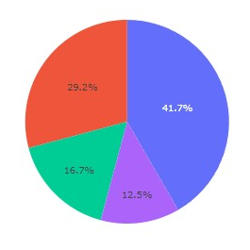

The exploratory data analysis results show that the important features to consider for predictive analysis later on are indeed the Payload Mass, Orbit type, FlightNumber, and Serial, among a few others.
Similar results can be seen from the interactive analytics demo (screenshot below).
The predictive analysis results show that all classification methods have the same accuracy (83%), so any of them are fine.
Results

Slide 17

Section 2

Slide 18
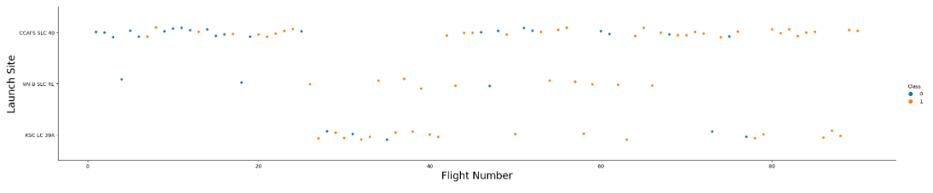
Flight Number vs. Launch Site
This plot show Launch Site vs Flight Number. Orange dots represent successful landing (of first stage) and blue the opposite.
This plot has a few insights, like for higher flight numbers with launch site CCAFS SLC 40, launches are largely successful
On the other hand, for lower flight numbers the success rate is rather mixed.
Similarly, for the VAFB SLC 4E launch site, launches are largely successful for mid-range flight numbers, but not for lower flight numbers.

Slide 19
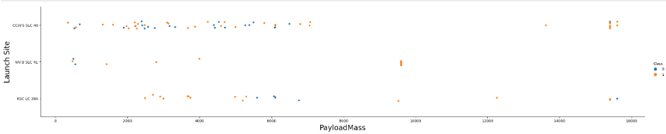
Payload vs. Launch Site
This plot show Launch Site vs Payload Mass. Orange dots represent successful landing (of first stage) and blue the opposite.
One insight here is that for higher Payload Mass with launch site CCAFS SLC 40, launches are largely successful.
On the other hand, it is quite mixed otherwise.
But the other launch sites seem to be mostly successful for any Payload Mass.

Slide 20
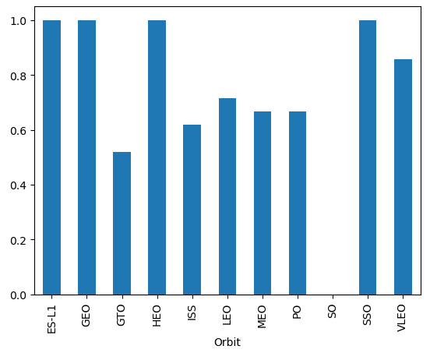
Success Rate vs. Orbit Type
This bar chart displays the success rates of the different orbit types
As you can see, there are 4 orbits that have perfect success rates.
Aside from VLEO, the others are not quite so great, hovering around 60%, and even SO with 0%.

Slide 21
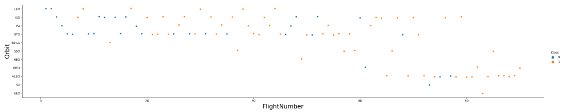
Flight Number vs. Orbit Type
This plot show Flight Number vs Payload Mass. Orange dots represent successful landing (of first stage) and blue the opposite.
One insight here is that the VLEO orbit higher flight numbers is largely successful.
On the other hand, it is quite mixed for the GTO orbit, hinting at no relationship.
But the ISS orbit might be more successful with higher flight numbers.

Slide 22
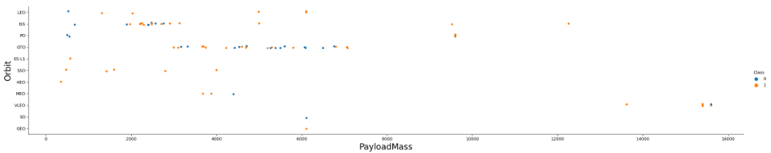
Payload vs. Orbit Type
This plot show Orbit type vs Payload Mass. Orange dots represent successful landing (of first stage) and blue the opposite.
One insight here is that for heavier payloads Polar, LEO, and ISS are more successful.
On the other hand, it is quite mixed for the GTO orbit again, hinting at no relationship.
Similarly for ISS with light Payloads.

Slide 23
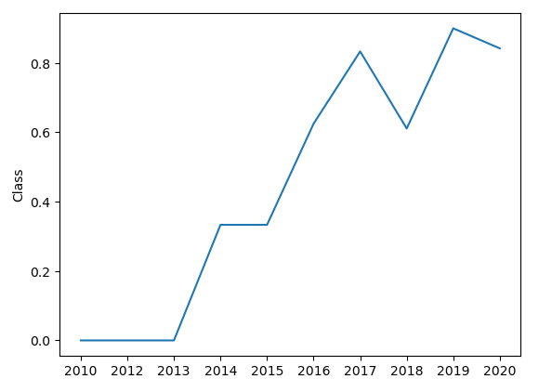
Launch Success Yearly Trend
This plot shows the yearly average success rate.
You can see a significant improvement, especially as we move towards 2017.
Note the minor dip in 2018, which seems to have corrected itself since 2019 has the highest success rate.

Slide 24
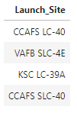
All Launch Site Names
A SQL query depicting unique launch site names
As you can see, there are only 4, which you should already be familiar with from previous the slides.

Slide 25
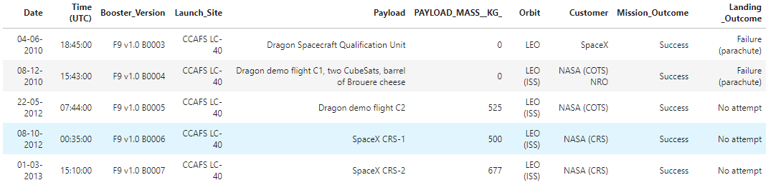
Launch Site Names Begin with 'CCA'
A SQL query with 5 records where launch sites begin with `CCA`
The reason for doing this is that there are two launch sites with names that start with 'CCA', which you saw in the last slide.

Slide 26
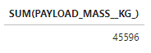
Total Payload Mass
The total payload carried by boosters from NASA
Note this is not the absolute total since we filtered for NASA customers only

Slide 27
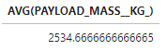
Average Payload Mass by F9 v1.1
The average payload mass carried by boosters version F9 v1.1
Note the actual average may vary since we filtered for the specific booster version that we care about here

Slide 28
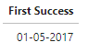
First Successful Ground Landing Date
The first successful landing outcome on ground pad was in 2017.
Note from the line chart a few slides ago, 2017 was also the year where average success rate went up.

Slide 29
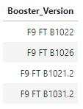
Successful Drone Ship Landing with Payload between 4000 and 6000
A SQL query depicting the names of boosters which had successful landings on drone ship with payload mass between 4000 and 6000
As you can see, there are only 4, signifying either a lack of data or poor success rate for this case

Slide 30
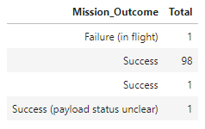
Total Number of Successful and Failure Mission Outcomes
A SQL query depicting the number of successful and failure mission outcomes
As you can see, when we disregard landing, success rate is quite high.

Slide 31
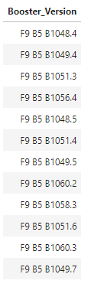
Boosters Carried Maximum Payload
A SQL query depicting the booster versions which carries the maximum payload mass
As you can see, there are various versions in the list, indicating the F9 B5 booster version can handle high payload mass

Slide 32
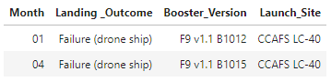
2015 Launch Records
The failed landing outcomes in drone ship, their booster versions, and launch site names for in year 2015
As you can see, since there are only two values, this may possibly hint at these feature values being favoured as they have a small number of failures

Slide 33
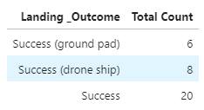
Ranking Landing Outcomes Between 2010-06-04 and 2017-03-20
A SQL query depicting the number of successful landing outcomes from 2010-06-04 to 2017-03-20
As you can see, the ground pad and drone ship success contribute to less than half the total success each

Slide 34

Section 3

Slide 35
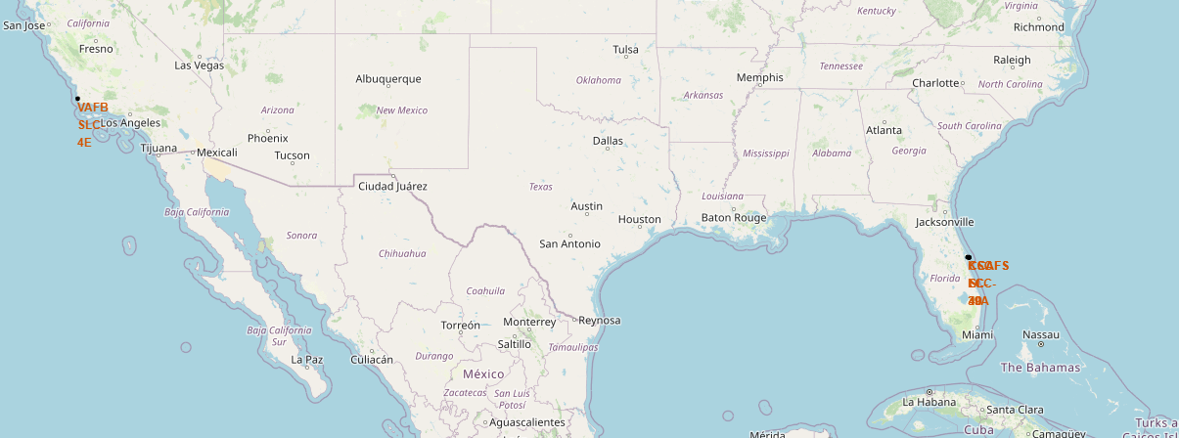
Marking Launch Sites on a Map (Folium 1)
In the below map you can see the locations of the launch sites. They are marked by black dots.
There are only two visible because three of the launch sites are actually right next to each other
Something to note about these launch sites is that they are all near the water and away from cities

Slide 36
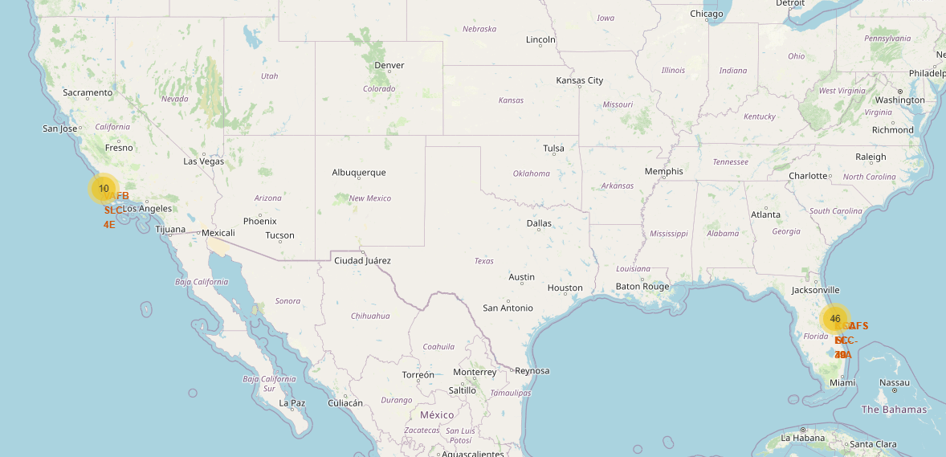
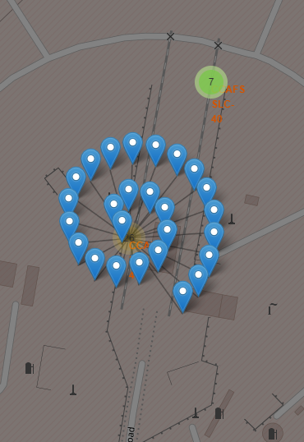
Marking Launch Outcomes with a Cluster (Folium 2)
Since the launch outcomes occur in the same site, this map has marker clusters to show them
By clicking on a launch site, you will see the launch outcome record in that launch site
For example, if you click on the CCAFS LC 40 site, you will see the image on the right above

Slide 37
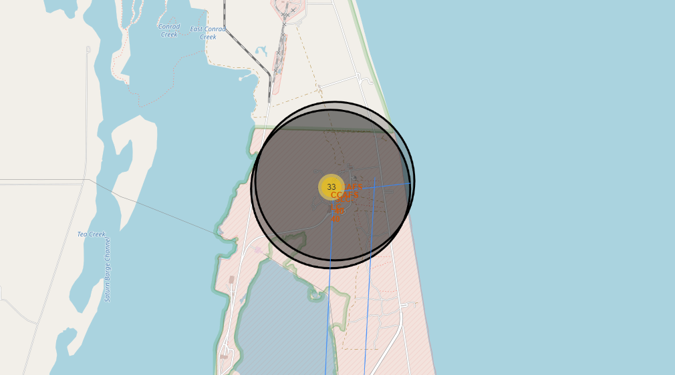
Marking Distances from Launch Sites to Notable Locations (Folium 3)
This map marks with a blue line how far a launch site is from a notable proximity
You can see a horizontal blue line in the image above, which shows how far the launch site is from the water
Alternatively, the lines going down extend to cities. This contrast shows that launch sites are always near low populated areas

Slide 38

Section 4

Slide 39
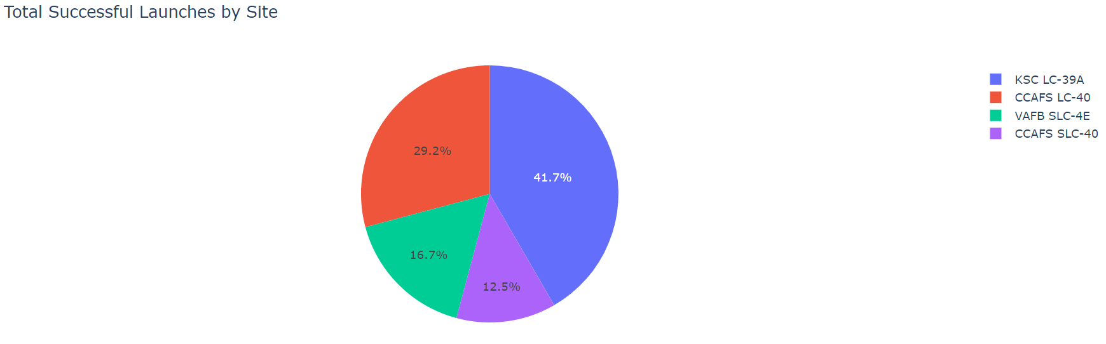
Comparing Launch Sites by their Successes
This pie chart clearly shows that the KSC LC-39A Launch Site has the most successes.
Though this may not be the whole story, as their individual launch rate is also important, it is a good sign for it at least.
Naturally, we can make the opposite assumption for the CCAFS SLC-40 Launch Site

Slide 40
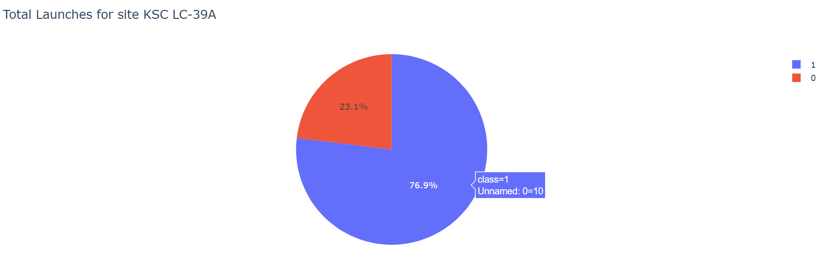
Launch Site with Highest Success Rate
This pie chart shows that the KSC LC-39A Launch Site has a success rate of almost 77% (blue is success and red is failure).
This is in fact the highest success rate, so our assumption from the last slide about this launch site being the best seems to be true.
Turns out the lowest success rate belongs to the launch site with the least amount of success from the last slide too.

Slide 41
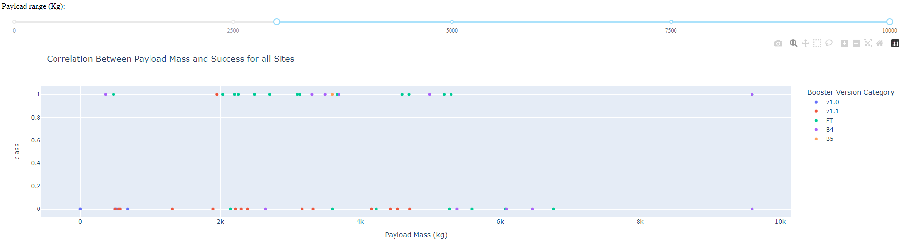
Comparing All Launch Site Successes for their Booster Version against Payload
From the plot you can see that the FT Booster Version has the highest success rate.
Moreover, the v1.1 seems to have the least success rate, while the others are rather mixed.
Furthermore, you can clearly see that higher payloads generally do not lead to many successes

Slide 42

Section 5

Slide 43
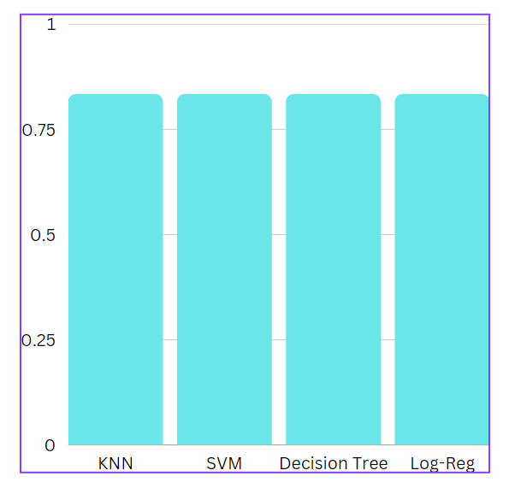
Classification Accuracy
The bar chart on the right is displays the accuracy on the test set of each model
As you can see, all models miraculously have the same accuracy, so there is no best one, or they all are!

Slide 44
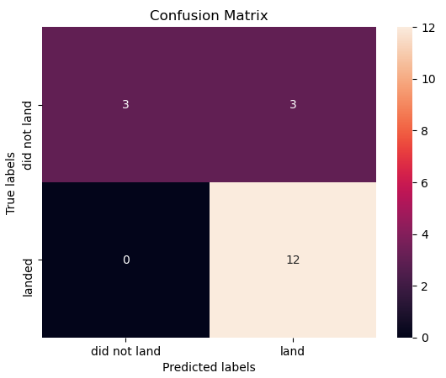
Confusion Matrix
Since each model had the same performance, they all have identical confusion matrices
Nonetheless, the confusion matrix on the right is from the decision tree model
Naturally from the 83% accuracy, the confusion matrix shows that the model did perform well
However, with zero false negatives, and a few false positives, we know the model could still be improved to catch these false positives better

Slide 45
Conclusions
From Data Collection and Wrangling steps, we know this data is a bit messy to begin with, so if starting from scratch be sure to perform the necessary pre-processing steps
Data Analysis shows some key highlights about the data, regarding certain relationships between different features and which ones may be irrelevant
It is important to note that dealing with null values is always tricky, and had they been handled differently than the way they were handled here, the data analysis results could possibly have been different
All classification models performed well but also the same. This is suspicious and may need further investigation
In any case, the models all missed some false positive cases, and no negative, so there is a clear weakness in the model to be further improved on

Slide 46
Appendix
A GitHub link to all files shared before and any other relevant files for this project: https://github.com/RavinderRai/Sucessful-SpaceX-Launch-Predictions

Slide 47


